Slide 1



Final Model Presentation : Predictive Modeling for Ebola Dynamics
BMED 4803
April 19th, 2017
Andrea Botero
Zinka Bartolek
Mohammed Saqib

Slide 2
Problem Statement & Application need
There exists a need to being able to predict the spread of infectious diseases (epidemics) through mathematical models, in order to understand their behavior and adequately implement measures that will be able to contain the spread, while dealing with data-records inconsistency and under-reporting.

Slide 3
Biomedical & Clinical Needs
Clean Data
Figure out the best fitting method to fill in for inconsistent data
Determine which model best predicts parameters of the Ebola spread
Varying parameters to model hypothetical situations
Apply results to predict best containment and interventions measures

Slide 4
Literature Review Summary
Papers | Methodology | Weaknesses
Althaus, 2014 Lindblade, et. al., 2015 Gomes, 2014 Meltzer, 2014 Xia et al., 2015 Rivers, 2014 Zaman, 2009 | ODE/SIR/SEIR Models - Modeling population as continuous variable functions over time | Real Populations are not continuous and may not be easily categorized into buckets Many parameters are assumed constant, even though they might be changing over time
Lewnard, 2014 Heesterbeek et al., 2015 | Bayesian Markov Chain Monte Carlo Model | Model used only for 1 city May fail if Markov Chain assumption not held

Slide 5
Literature Review Summary
Papers | Methodology | Weaknesses
Chowell, 2015 | Function fitting - Use predetermined functions without differential equations, and estimate hyperparameters of system | Overfitting of hyperparameters if a wrong or inappropriate base function is used
Ajelli, 2013 Zhang, 2015 | Spatial/ Agent-Based - Using simulations of population with granular individuals | Computationally expensive, significant assumptions about individuals and interactions
Siettos, et. al. 2015 | Hybrid - Use small agent-based model to obtain hyperparameters for model | Calculation can be slow, but overall good representation
Yilmaz, et. al. 2015 | Graph Agent-Based model | Connection in real life hard to quantify; makes many assumptions

Slide 6
Data characteristics
Sample size:
131 time points of cumulative deaths and infected data
Guinea, Sierra Leone and Liberia
Source:
Data available from the World Health Organization (WHO) for the current Ebola outbreak: http://www.who.int/csr/disease/ebola/situation- reports/archive/en/.
Quality:
Issue in cumulative reporting
Time inconsistency

Slide 7
Methodology Workflow Diagram
Sierra Leone
Clean first half of data: Exponential Fitting⁵
Clean second half of Data: Polynomial Fitting⁵
Gather Data
Total cumulative cases and deaths
Guinea
Clean first half of data: Exponential Fitting⁵
Clean second half of Data: Polynomial Fitting⁵
Liberia
Clean first half of data: Exponential Fitting⁵
Clean second half of Data: Polynomial Fitting⁵
5. Chowell, G., Viboud, C., Hyman, J. M., & Simonsen, L. (2014). The Western Africa Ebola Virus Disease Epidemic Exhibits Both Global Exponential and Local Polynomial Growth Rates. PLoS Currents. doi:10.1371/currents.outbreaks.8b55f4bad99ac5c5db3663e916803261
Notes:
In addition to the exponential fitting, have a few more methods to clean data

Slide 8
Methodology Workflow Diagram
Sierra Leone
ODE SIR model
Gather Clean Data
Construct Models in MATLAB
Guinea
ODE SEIR model
Liberia
Agent Based Spatial + Markov Model
Notes:
In addition to the exponential fitting, have a few more methods to clean data

Slide 9
Methods: Data Fitting and Cleaning
Exponential fitting (1st half of the data):
Using the matlab fit function
Literature suggested that early disease growth is exponential
Polynomial fitting (2nd half of the data):
Using the 5th order polynomial function
Literatures shows attenuation of disease growth, increase in decline
Interpolation between Days
Data irregularly sampled over time
Interpolation gave per-day data during entire epidemic
Interpolation Currently Infected from Cumulative Cases
Use domain knowledge of average time for infection and incubation period
Generate currently infected data for use

Slide 10
Approach to Finding Model Parameters
Used fminsearch using minimum error
Multiple error measures attempted
Cumulative
Pros: Don’t need to interpolate from cumulative data
Cons: Unable to get model to get close to data
Cross Validation
Pros: Try to ensure no overfitting and that model can apply to other sets
Cons: Key patterns in West Africa 2014 Ebola Epidemic are not applicable to other Ebola outbreaks. Attempt to use Cross Validation fails to work in reasonable time period.
Single Day
Pros: Compare single day by single day. Simple, gets good results.
Cons: Interpolate day by day from cumulative data

Slide 11
Cross-Validation
Does not complete using fminsearch
Fails converge
Generalizing Data?
Is a single Ebola Epidemic truly generalizable?
Unable to prevent significant error in all models even when test set = training set
Data quality needs further cleaning
Final Choice is using Training Error

Slide 12
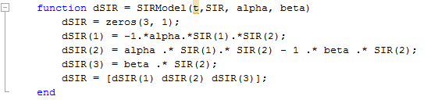
Model 1: SIR
Equations used:
Strengths: Quick, Simple, Computationally Easy
Weaknesses: Continuous assumption, Assumes all of S interacts with all of I

Slide 13
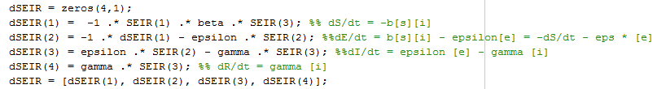
Model 2: SEIR
Equations used:
Strengths: Quick, Simple, Computationally Easy
Weaknesses: Continuous assumption, Assumes all of S interacts with all of I

Slide 14
Model 3: Spatial + Markov Agent-Based Modeling
Agent- Based graph
Simple Markov model
State is infected, not infected, alongside with status for each neighbor
Each neighbor ‘interacts’ and probabilistically infects agent
Function:
AgentBasedGraph(country, numPeople, numInfected, numConnections, numTimeSteps, infectiousConst, recoveryConst)
Strengths:
More accurate representation, accounts for the fact that not all S population interacts with I, connections and vertices based on population and districts
Weaknesses:
Takes more time to complete
Too random

Slide 15
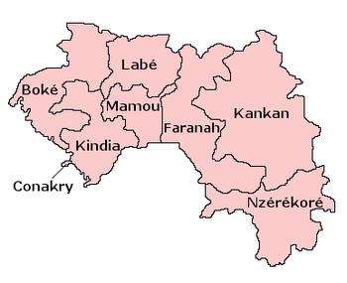
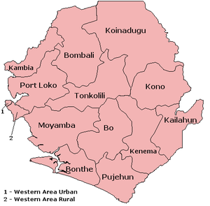
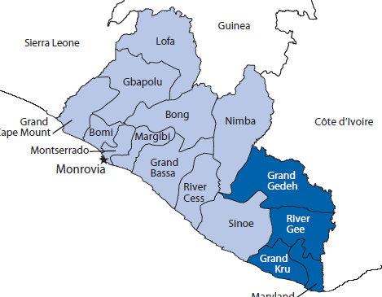
Agent Based Spatial Graph Using Districts
Guinea¹⁷
Sierra Leone¹⁸
Liberia¹⁸
Each country represented as graph of districts with adjacency list for neighboring districts.
Notes:
USe information from districts, to make spatial model more accurate. Specifically their populationa nd connections to each other

Slide 16
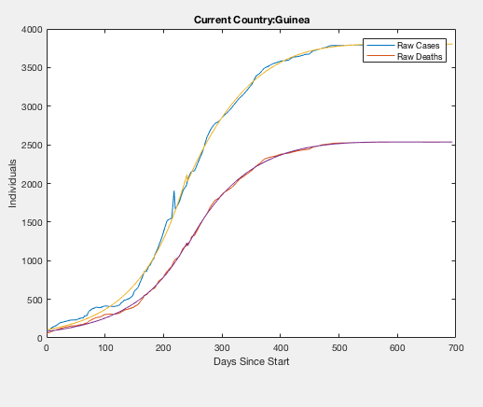
Preliminary Results: Data Fitting

Slide 17
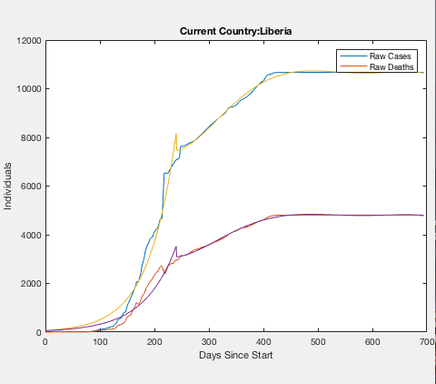
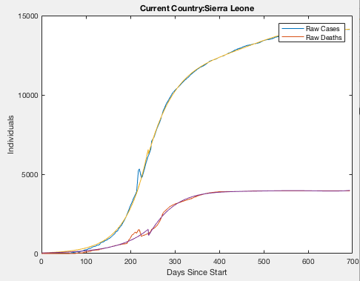
Preliminary Results: Data Fitting

Slide 18
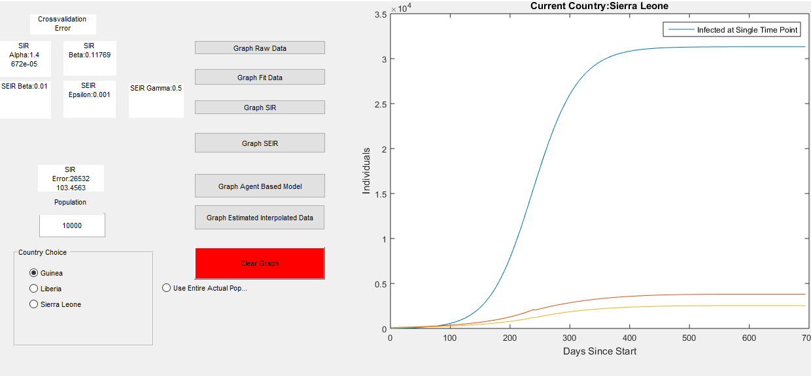
Preliminary Results: SIR
Notes:
Fix legend for recovered, susceptible.

Slide 19
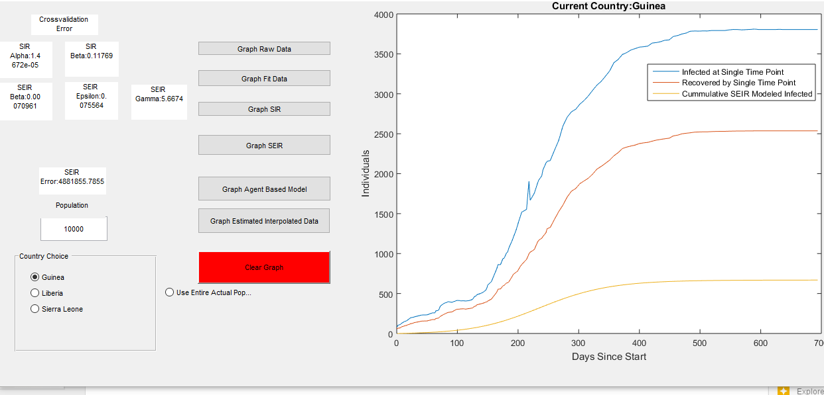
Preliminary Results: SEIR

Slide 20
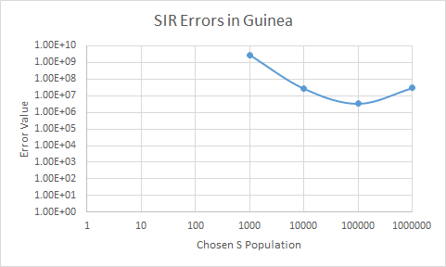
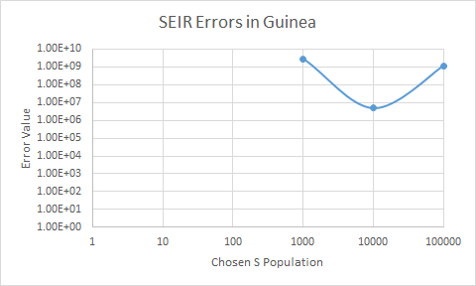
Exploring different parameters: SIR & SEIR
Using exact population results in astronomical error:
Assumptions of ODE models not held up for epidemic!

Slide 21
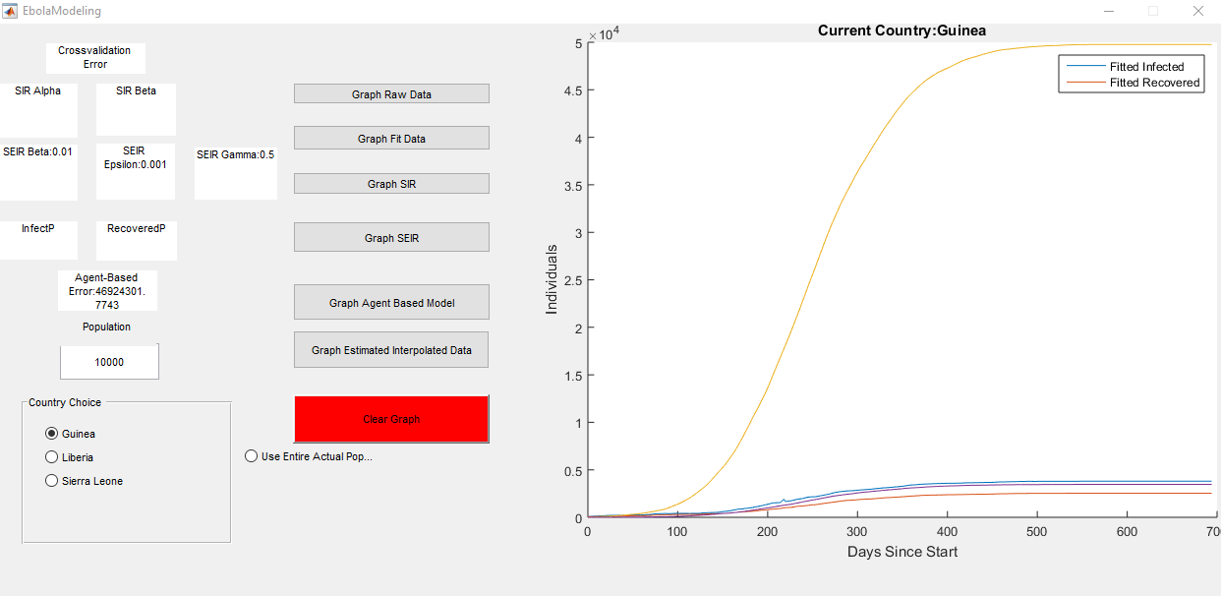
Preliminary Results: Agent-Based Model
Doesn’t handle large number of agents
10,000 people
Attempt to show small independent networks of people, instead of entire population
More parameter searching needed - See report
Attempt to use random restarts for further work here
Notes:
https://upload.wikimedia.org/wikipedia/commons/thumb/1/1c/Guinea_Regions.png/350px-Guinea_Regions.png
https://upload.wikimedia.org/wikipedia/commons/thumb/d/d9/Sierra_Leone_Districts.png/300px-Sierra_Leone_Districts.png

Slide 22
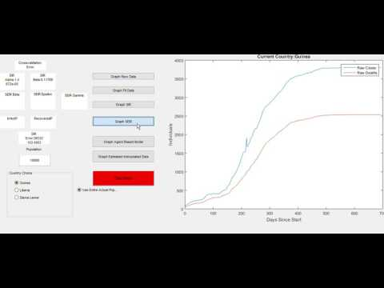
Tool: GUI

Slide 23
Conclusions & Future Work
Several challenged exist when modeling spread disease
Data inconsistency
Underreporting
More extensive Spatial Model, given more time and computational power
Including more compartments in SIR model
More time: fminsearch takes a lot of time, especially for agent-based graph

Slide 24
References
Gomes, M. F., Piontti, A. P., Rossi, L., Chao, D., Longini, I., Halloran, M. E., & Vespignani, A. (2014). Assessing the International Spreading Risk Associated with the 2014 West African Ebola Outbreak. PLoS Currents. doi:10.1371/currents.outbreaks.cd818f63d40e24aef769dda7df9e0da5
Lewnard, J. A., Mbah, M. L., Alfaro-Murillo, J. A., Altice, F. L., Bawo, L., Nyenswah, T. G., & Galvani, A. P. (2014). Dynamics and control of Ebola virus transmission in Montserrado, Liberia: a mathematical modelling analysis. The Lancet Infectious Diseases, 14(12), 1189-1195. doi:10.1016/s1473-3099(14)70995-8
Meltzer, M. I., Atkins, C. Y., Knust, B., Ervin, E. D., Nichol, S. T., Damon, I. K., & Washington, M. L. (2014). Estimating the Future Number of Cases in the Ebola Epidemic —Liberia and Sierra Leone, 2014–2015. Morbidity and Mortality Weekly Report, 63.
Althaus, C. L. (2014). Estimating the Reproduction Number of Ebola Virus (EBOV) During the 2014 Outbreak in West Africa. PLoS Currents. doi:10.1371/currents.outbreaks.91afb5e0f279e7f29e7056095255b288
Chowell, G., Viboud, C., Hyman, J. M., & Simonsen, L. (2014). The Western Africa Ebola Virus Disease Epidemic Exhibits Both Global Exponential and Local Polynomial Growth Rates. PLoS Currents. doi:10.1371/currents.outbreaks.8b55f4bad99ac5c5db3663e916803261
Lindblade, K. A., & Kateh, F, et. al. (2015, October 10). Decreased Ebola Transmission after Rapid Response to Outbreaks in Remote Areas, Liberia, 2014 (United States, CDC, Emerging Infectious Diseases). Retrieved March 1, 2017.
Siettos C, Anastassopoulou C, Russo L, Grigoras C, Mylonakis E. Modeling the 2014 Ebola Virus Epidemic – Agent­Based Simulations, Temporal Analysis and Future Predictions for Liberia and Sierra Leone. PLOS Currents Outbreaks. 2015 Mar 9 . Edition 1. doi: 10.1371/currents.outbreaks.8d5984114855fc425e699e1a18cdc6c9.
Ajelli, M., & Fumanelli, L. (2013). Spatiotemporal dynamics of the Ebola epidemic in Guinea and implications for vaccination and disease elimination: a computational modeling analysis. BMC Medicine, 14(1), 130. doi:10.1186/s12916-016-0678-3
Notes:
APA citations

Slide 25
References
Zhang, P., & E. (2015). The Large Scale Machine Learning in an Artificial Society: Prediction of the Ebola Outbreak in Beijing. Computational Intelligence and Neuroscience,2015. http://dx.doi.org/10.1155/2015/531650
Pruyt, E., Auping, W. L., & Kwakkel, J. H. (2015). Ebola in West Africa: Model-Based Exploration of Social Psychological Effects and Interventions. Systems Research and Behavioral Science, 2015(32), 2-14. doi:10.1002/sres.2329
Heesterbeek, H., Anderson, R. M., Andreasen, V., Bansal, S., Angelis, D. D., Dye, C., . . . Viboud, C. (2015). Modeling infectious disease dynamics in the complex landscape of global health. Science, 347(6227). doi:10.1126/science.aaa4339
Rivers, Caitlin M., Eric T. Lofgren, Madhav Marathe, Stephen Eubank, and Bryan L. Lewis. "Modeling the Impact of Interventions on an Epidemic of Ebola in Sierra Leone and Liberia." PLoS Currents (2014): n. pag. Web.
Xia, Z., Wang, S., Li, S., Huang, L., Zhang, W., Sun, G., . . . Jin, Z. (2015). Modeling the transmission dynamics of Ebola virus disease in Liberia. Scientific Reports,5(1). doi:10.1038/srep13857
Zaman, G., Kang, Y. H., & Jung, I. H. (2009). Optimal treatment of an SIR epidemic model with time delay. Biosystems, 98(1), 43-50. doi:10.1016/j.biosystems.2009.05.006
Lekone, P. E., & Finkenstädt, B. F. (2006). Statistical Inference in a Stochastic Epidemic SEIR Model with Control Intervention: Ebola as a Case Study. Biometrics, 62(4), 1170-1177. doi:10.1111/j.1541-0420.2006.00609.x
http://www.informs-sim.org/wsc15papers/012.pdf
https://upload.wikimedia.org/wikipedia/commons/thumb/1/1c/Guinea_Regions.png/350px-Guinea_Regions.png
https://upload.wikimedia.org/wikipedia/commons/thumb/d/d9/Sierra_Leone_Districts.png/300px-Sierra_Leone_Districts.png
Notes:
APA citations

Slide 26
Discussion
Andrea Botero: abotero8@gatech.edu
Zinka Bartolek: zbartolek@gatech.edu
Mohammed Saqib: saqibm128@gatech.edu

